Slide 1
CORONA: VIJAY APP
Freedom from Social Distancing

Slide 2
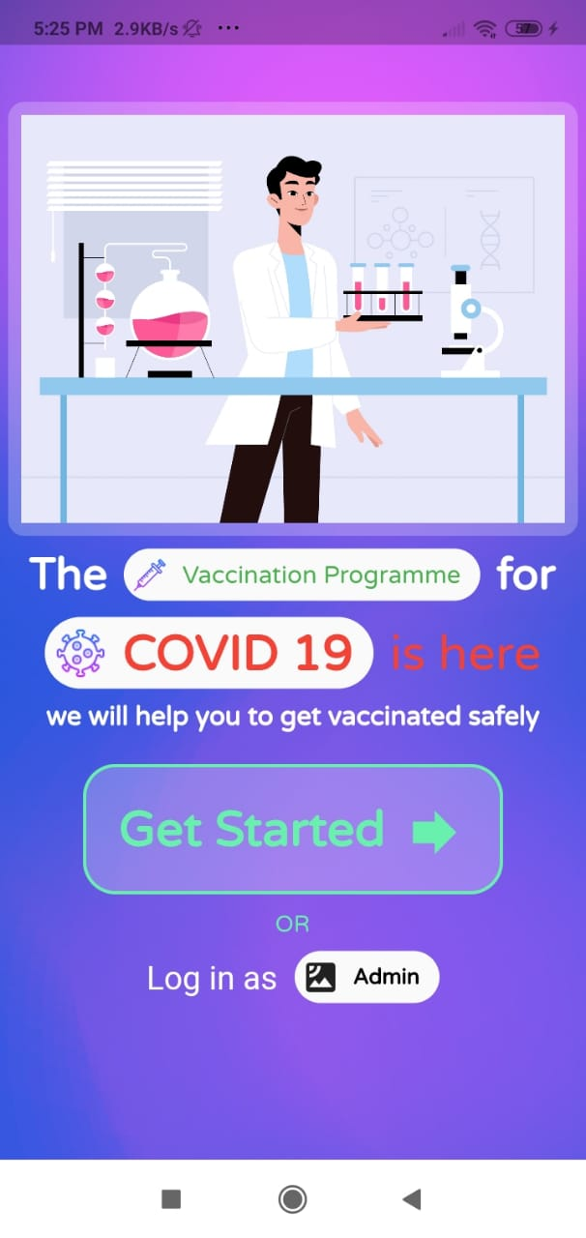
INTRODUCTION
The Vijay App is all about how a person can be vaccinated safely, anywhere and with proper management system.

Slide 3
TABLE OF CONTENTS
01
02
03
About the Vijay App
Ideology and Working
Increase Adherence rate
Development of CHATBOT to make interaction easier
Ensuring Portability for Citizens
FACE RECOGNITION system for unique entry

Slide 4
TABLE OF CONTENTS
04
05
06
Queue Management System
Prioritising the citizens for vaccination
Report regarding AEFI/AESI
Data entry system for any issue/complaint
Supply Chain of Vaccine
Prediction Model by using physical factors

Slide 5
01
About VIJAY App

Slide 6
VIJAY APP
Have you ever wondered even if covid vaccine is made available to you, this time of quarantine will remain for a very long time why so?
How would vaccination be provided in a country with a population of 138 crore??
So here is our app which resolve all these issues :)

Slide 7
IDEOLOGY OF VIJAY APP?
Bring People to dedicated center for Vaccination process of Covid-19.
Assuming certain amount of Vaccine supply daily. On this basis, we will call people to a dedicated center located near to their home.
A certain date will be allotted to everyone for their vaccination in the respective centers.
Repetition will be check by the unique AADHAR Card numbers or through FACE RECOGNITION system.

Slide 8
WORKING OF INTERFACE
A certain date will be display on user screen on which they are supposed to come to the designated center for vaccination.
This date will be generated by a certain algorithm that considers the following factors in mind.
1. Vaccine Supply available on daily basis.
2. Priority order with which people will be called are as follows:-
a. Frontline Healthcare Workers.
b. People at certain risk
c. Children and Senior Citizens
d. All others.

Slide 9
WORKING…
Now, we assume that a database consisting of required records is already available.
Citizens can be identified using their unique aadhaar card number. This database will be used to predict the correct date for vaccination.
One administrator (who will be present at the dedicated covid center) will be given special access to the COVID: Vijay App so that he/she can check who is vaccinated and assign the person who has been vaccinated in the database through the app interface.

Slide 10
02
Increase Adherence Rate

Slide 11
Increasing Adherence rate from front line Health workers
For easing the data entry for Front Line Health Workers, a CHATBOT is designed.
It guides the admin (the person who manages data entries) to use this app.
Explaining different sections, which all data is to entered.
It can be made more robust by adding Multi Language Support and speaking feature.

Slide 12
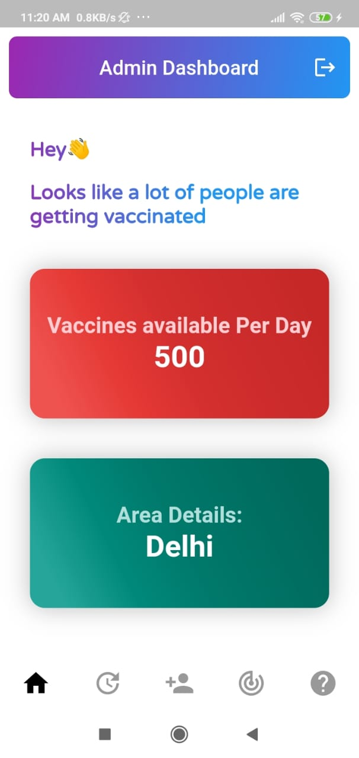
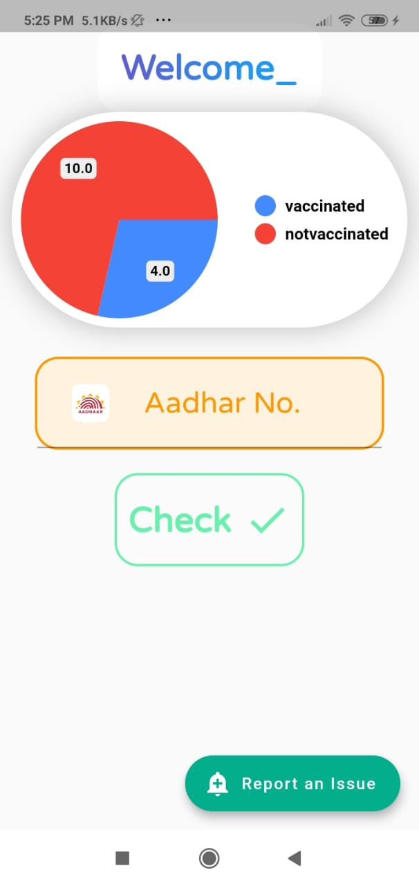
Admin Interface
User Interface

Slide 13
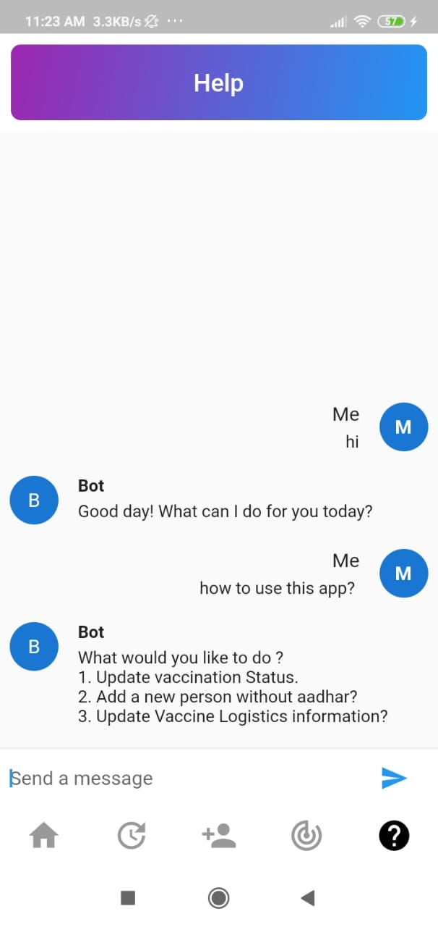
01
02
BOT
User
Gives easy instructions
Query regarding any function of the application

Slide 14
03
Ensuring Portability of Vaccine

Slide 15
To ensure portability across the country to account for travel/migration
To decrease delicacy while vaccinating Identity of everyone is to be checked.
It's basically done by AADHAR CARD (unique number).
Citizens without Aadhaar Card would be identified using unique Face Identity i.e. FACE RECOGNITION system.
In case, the image is present it won’t be added to the database again. We also ask for following information: -
a) Name
b) Age
c) Occupation
d) Address
e) Any specific risk from COVID

Slide 16
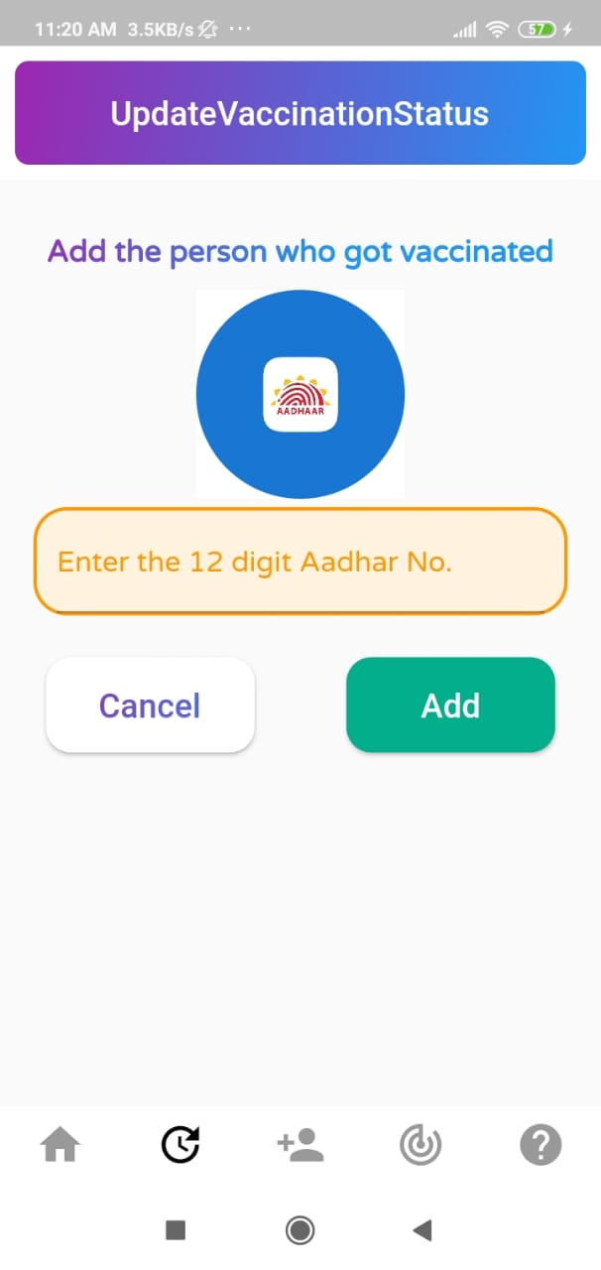
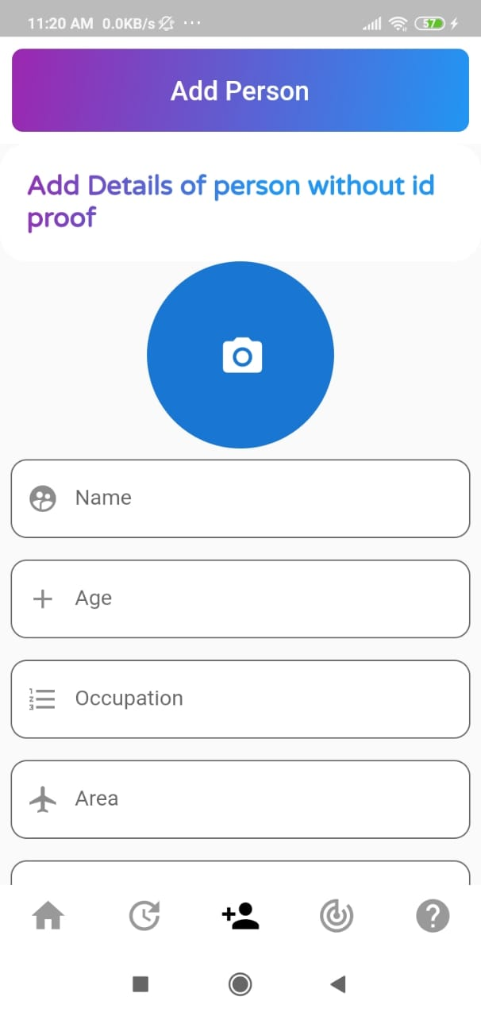
Citizen with AADHAR Card
Adding new entry without ID proof

Slide 17
04
Queue Management System

Slide 18
Queue management system
A certain date will be displayed on user screen on which they are supposed to come to the
Designated center for vaccination.
Date on which citizen has to come for vaccination will be decided as follows: -
1. Vaccine Supply available on daily basis.
2. Priority order with which people will be called are as follows: -
a. Frontline HealthCare Workers
b. Citizens at risk
c. Senior Citizens
d. Rest all others
In case a citizen misses the vaccination date, new vaccination date shall be given to him/her accordingly. This will be done for each zone separately.

Slide 19
Enter Aadhar Number
01
02
Check Appointment

Slide 20
05
Report regarding AEFI/AESI

Slide 21
Report regarding AEFI (Adverse Event Following Immunization) and AESI (Adverse Event of Special Interest)
AEFI / AESI reporting can be done through a section in the app where admin and citizens can fill the desired details. These details will be stored in database for further analysis.
The following details are asked:
1. Name
2. Age
3. Aadhar number
4. Description of Symptoms
5. Allergic (Yes/No)
6. Fever (Yes/No)

Slide 22
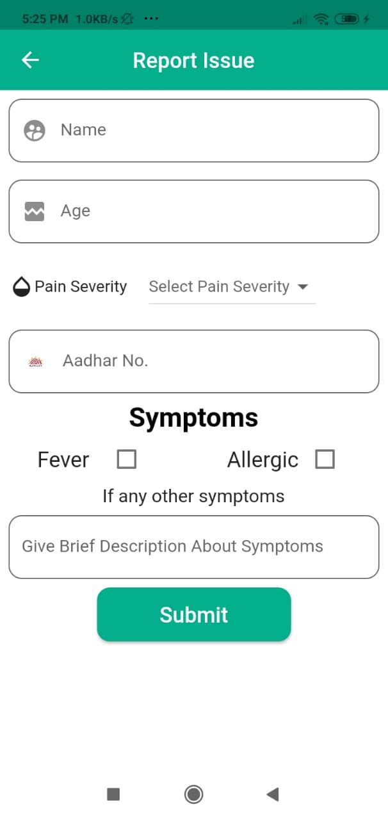
User Details
AADHAAR Number
Symptoms

Slide 23
06
Supply Chain of Vaccine

Slide 24
Supply chain and inventory management of vaccine
Admin will update the Vaccine Logistics Management Information through the form provided in the app.
Based on these values, our system will predict the number of vaccines that should be dispatched to prevent loss.
Factors that we take into consideration are Humidity, Temperature, Traffic Density.
Required information will be stored in a database as well.

Slide 25
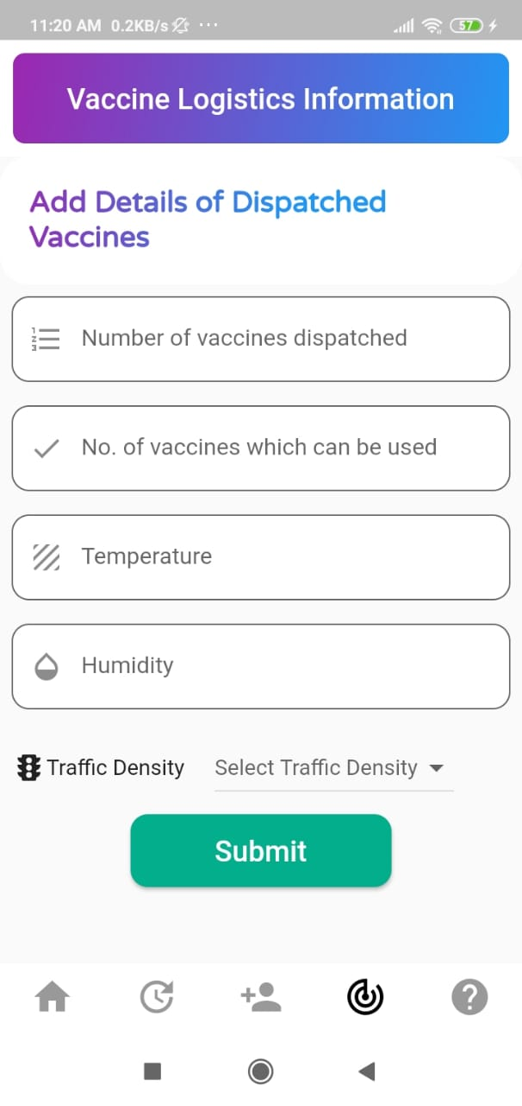
01
Vaccines Dispatched
02
Usable vaccines
03
Temperature
04
Humidity
05
Traffic Density

Slide 26
TECHNOLOGY USED

Slide 27




HTML
css
Flutter
JS

Slide 28



Django
Django-rest framework
Machine learning

Slide 29
TEAM
Thank You By:
Geeky Igniters
Sanidhiya
Nitish
Naman
Vibha
Swapnil

